Slide 1


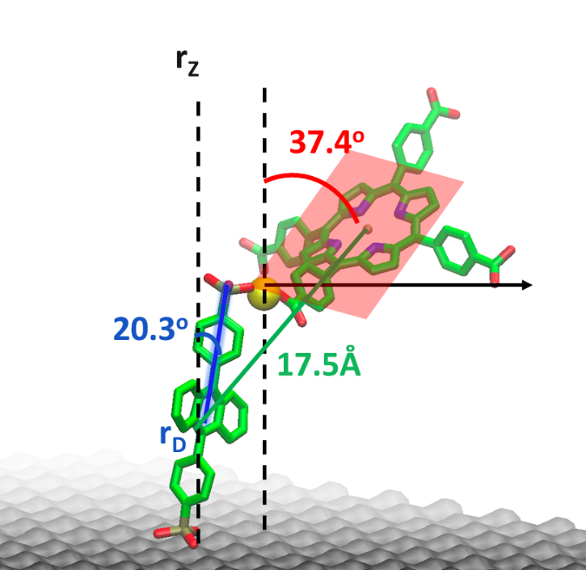
Understanding and Controlling Molecular Excited State Processes Using Metal Oxide Interfaces
Kenneth Hanson
Department of Chemistry & Biochemistry
Florida State University, Tallahassee, FL, USA

Slide 2
Molecular Photochemistry/Photophysics
phosphorescence
internal
conversion
fluorescence
intramolecular charge transfer
hν
conformational change
Molecule
electron transfer
photochemical transformation
proton transfer
exiplex formation
energy transfer
excimer formation

Slide 3
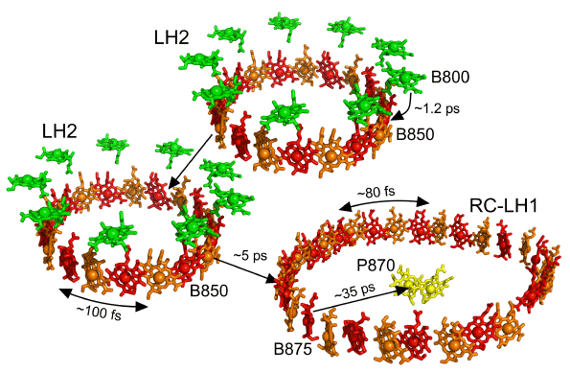
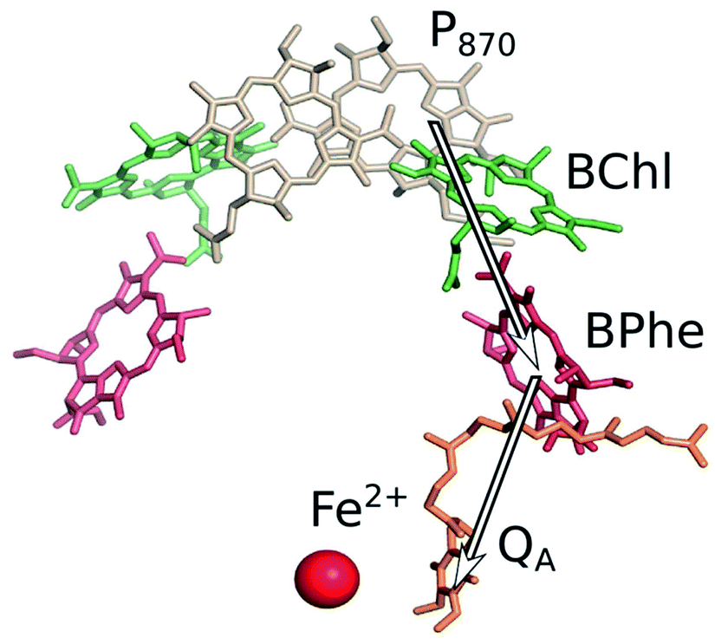
Molecular Photochemistry/Photophysics
Energy Transfer
Electron Transfer
Sundström et al. J. Phys. Chem. B 1999, 103, 2327-2346.
Lundholm et al. RSC Adv. 2014, 4, 25502-25509.

Slide 4
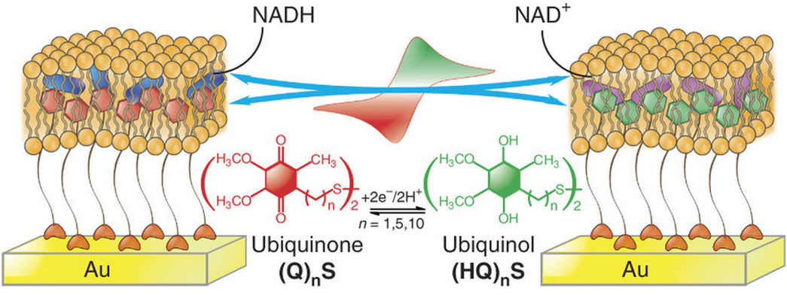
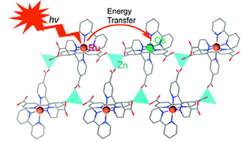
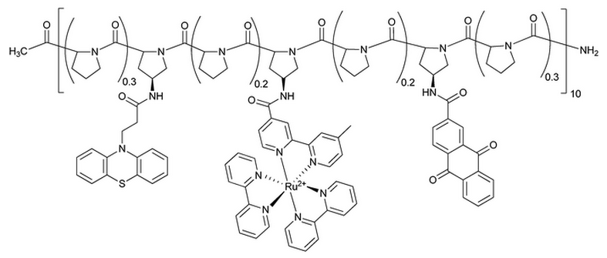
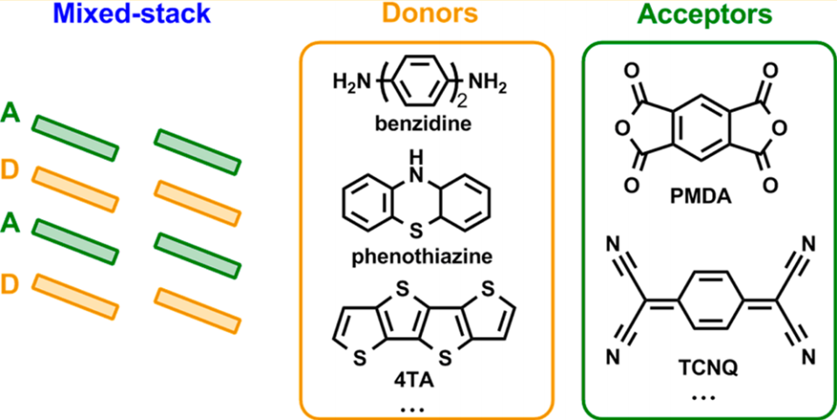
Structural Control: Humans
Phospholipid Bilayers
Metal Organic Frameworks
Ma et. al. Nature Protocols, 2013, 8, 439
Kent et. al. J. Am. Chem. Soc., 2010, 132, 12767
Polypeptides
Crystals
Slate et. al. J. Am. Chem. Soc., 1998, 120, 4885
Zhu et. al. J. Phys. Chem. C, 2014, 118, 14150

Slide 5

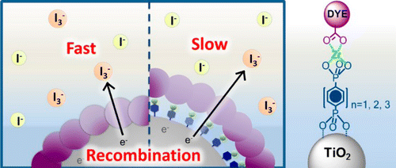
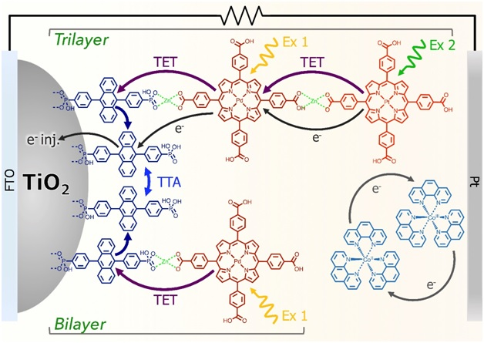
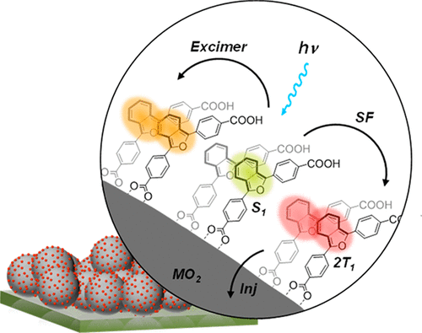
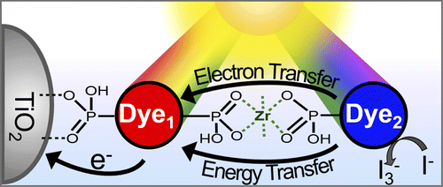
Metal Ion-Linked Multilayer
NanoMO₂
Control e⁻ Transfer
Photon Upconversion
Singlet Fission
Energy/e⁻ Cascade
5

Slide 6
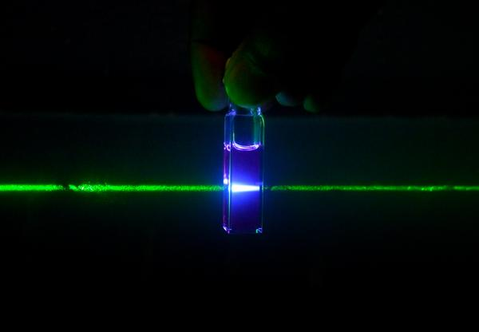
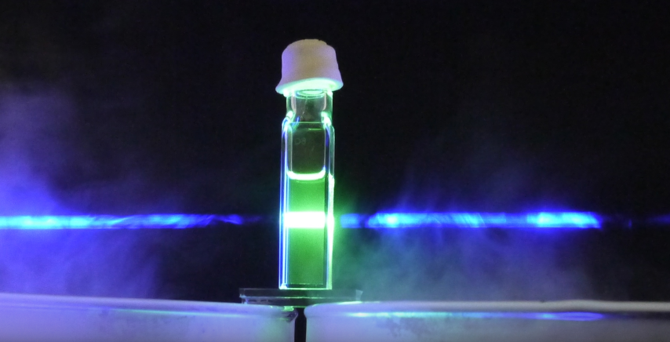
Down Conversion vs. Upconversion
S₃
S₂
IC
IC
S₁
hν_{ex}
hν_{em}
S₀
hν → hν
hν → hν

Slide 7
Photon Upconversion
S₁
S₁
(5)
S₁
S₁
(2)
(4)
T₁
T₁
T₁
T₁
(3)
(1)
hν
hν
S₀
S₀
Sensitizer
Annihilator
Annihilator
Sensitizer
2 hν → hν

Slide 8
Photon Upconversion
S₁
(5)
S₁
(4)
T₁
T₁
hν
S₀
Annihilator
Sensitizer
2 hν → hν

Slide 9
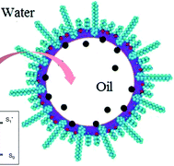
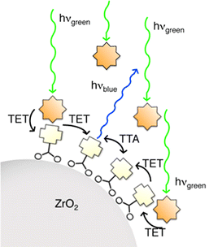
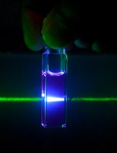
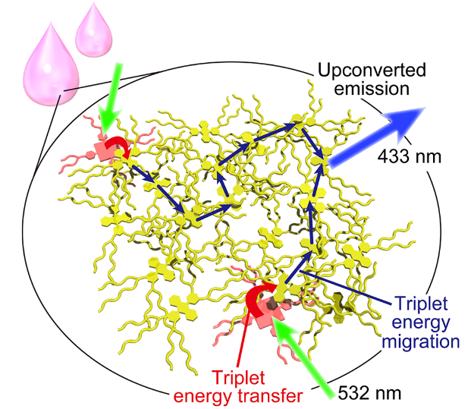
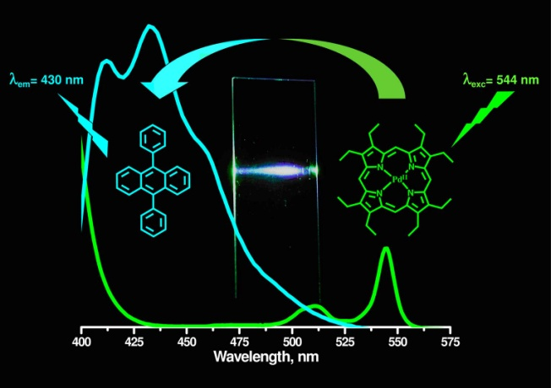
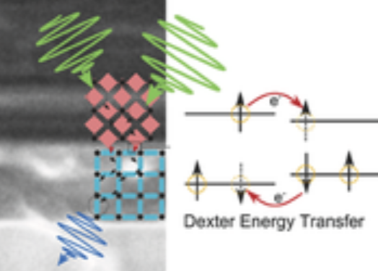
Sensitizer-Annihilator Interactions
Solution
Microemulsion
Heterogeneous
Chem. Commun., 2004, 2860
Photochem. Photobiol. Sci. 2014, 13, 48
J. Phys. Chem. C, 2013, 117, 14493
Polymer Films
Neat-solvent
MOF
JACS 2007, 129, 12652
JACS 2013, 135, 19056
JACS 2016, 138, 6541

Slide 10

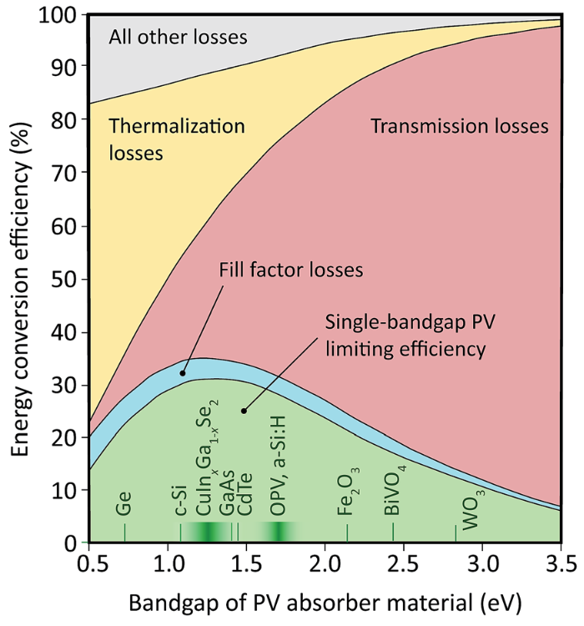
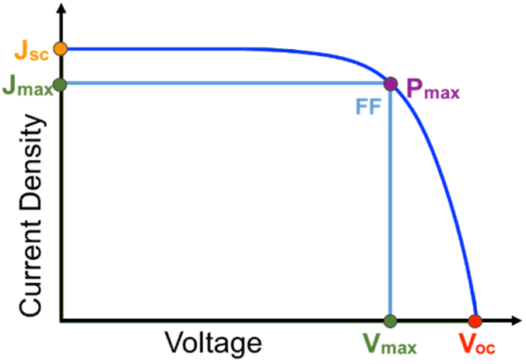
Solar Cell Efficiency
Schulze and Schmidt Energy Environ. Sci. 2015, 8, 103-125
P_{in} = 100 mW/cm² (AM1.5)
P_{max} = J x V
V_{oc}
SQ Limit
1.3 ev
Max Theoretical Efficiency
hν
hν
hν
hν
V_{oc}
Standard solar cell ~33%
1.3 eV bandgap
Large BG
High V, Low J
Small BG
Low V, High J

Slide 11
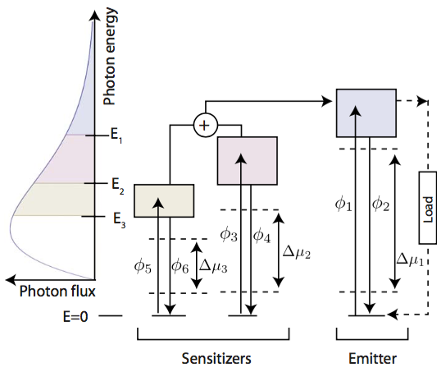
Solar Cell Efficiency
Schulze and Schmidt Energy Environ. Sci. 2015, 8, 103-125
Perovskites, OPV, DSSC
with TTA-UC
Max Theoretical Efficiency
Standard solar cell ~33%
1.3 eV bandgap
Solar cell with upconversion > 45%
Ekins-Daukes and Schmidt,
Appl. Phys. Lett., 2008 93, 063507.
1.76 eV bandgap

Slide 12
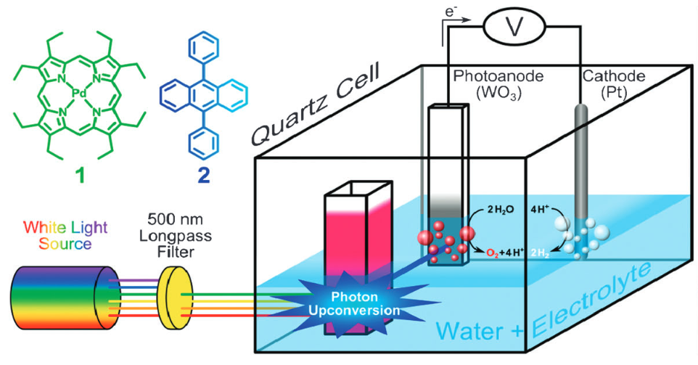
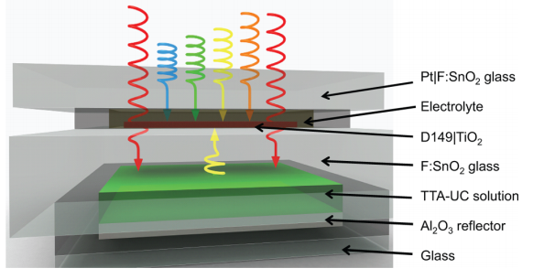
Harnessing TTA-UC
Optical Coupling:
(4)
(2)
Transmission
Light absorption and TTA
Upconverted emission
Absorption by a solar cell
hν
(3)
hν
S
A*
A
(1)
Solar Cell
Upconversion Solution/Film
Chem. Commun. 2012, 48, 209.
J. Phys. Chem. Lett. 2013, 4, 2073.

Slide 13
Harnessing TTA-UC
Optical Coupling:
(4)
(2)
Transmission
Light absorption and TTA
Upconverted emission
Absorption by a solar cell
hν
(3)
hν
S
A*
A
(1)
Solar Cell
Upconversion Solution/Film
Electronic Coupling:
(1)
(2)
hν
Light absorption and TTA
Photocurrent Generation
A*
e⁻
S
A
No isotropic emission
No self-absorption
Increase sensitizer concentration
Upconversion Solar Cell
Need A* at a charge separation interface!

Slide 14
Metal Ion-Linked Multilayer
NanoMO₂
S and A in proximity
A-A interactions
On a charge separation interface
Easy DSSC integration
Hill et al. J. Phys. Chem. Lett. 2015, 6, 4510.

Slide 15
Metal Ion-Linked Multilayer
NanoMO₂

Slide 16
TTA-UC Emission
λ_{ex} = 532 nm (1 W/cm²)
Φ = 0.0023
Hill et al. J. Phys. Chem. Lett. 2015, 6, 4510.

Slide 17


TTA-UC Emission
Weak TTA Limit
Strong TTA Limit
Slope = 2
Slope = 1
Castellano et al. J. Phys. Chem. Lett. 2012, 3, 299-303.
Hill et al. J. Phys. Chem. Lett. 2015, 6, 4510.

Slide 18
Mechanism
CB
e⁻
S₁
e⁻
S₁
S₁
CB
S₁
ISC
T₁
ISC
T₁
T₁
T₁
ET
hν
ET
hν
E
hν
e⁻
S₀
e⁻
S₀
S₀
S₀
D/D⁺
VB
A
Zn
S
VB
A
Zn
S
ZrO₂
TiO₂
Upconverted Emission!
Photocurrent?

Slide 19
TTA-UC Photocurrent
On ZrO₂: Upconverted Emission
ZrO₂-ML
λ_{ex} = 532 nm
MeCN
J. Phys. Chem. Lett. 2015, 6, 4510.
On TiO₂: Upconverted Photocurrent
TiO₂-ML
V
Co(bpy)₃^{2+/3+}
MeCN
Pt counter electrode

Slide 20
TTA-UC Photocurrent
J_{sc}/V_{oc} greater than the sum of its parts.
J_{sc}= 0.009 mA/cm²
Demonstrated an integrated TTA-UC solar cell.
η = 1.6 x 10⁻⁵ %
ACS Energy Lett. 2016, 1, 3-8.
On TiO₂: Upconverted Photocurrent
TiO₂-ML
V
Co(bpy)₃^{2+/3+}
MeCN
Pt counter electrode

Slide 21
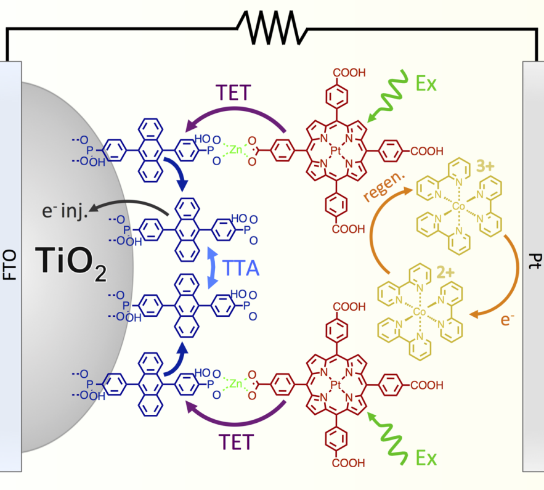
Increasing UC Photocurrent (J_{UC})
JPC Lett., 2018, 9, 5810
9 μA/cm²
ACS Energy Lett. 2016, 1, 3-8.

Slide 22
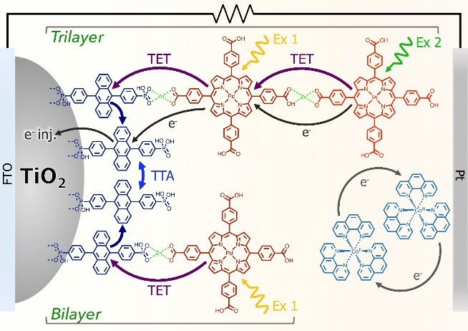
Increasing UC Photocurrent (J_{UC})
JPC Lett., 2018, 9, 5810
78 μA/cm²
J. Mater. Chem. A, 2017, 5, 11652-11660.
9 μA/cm²
ACS Energy Lett. 2016, 1, 3-8.

Slide 23
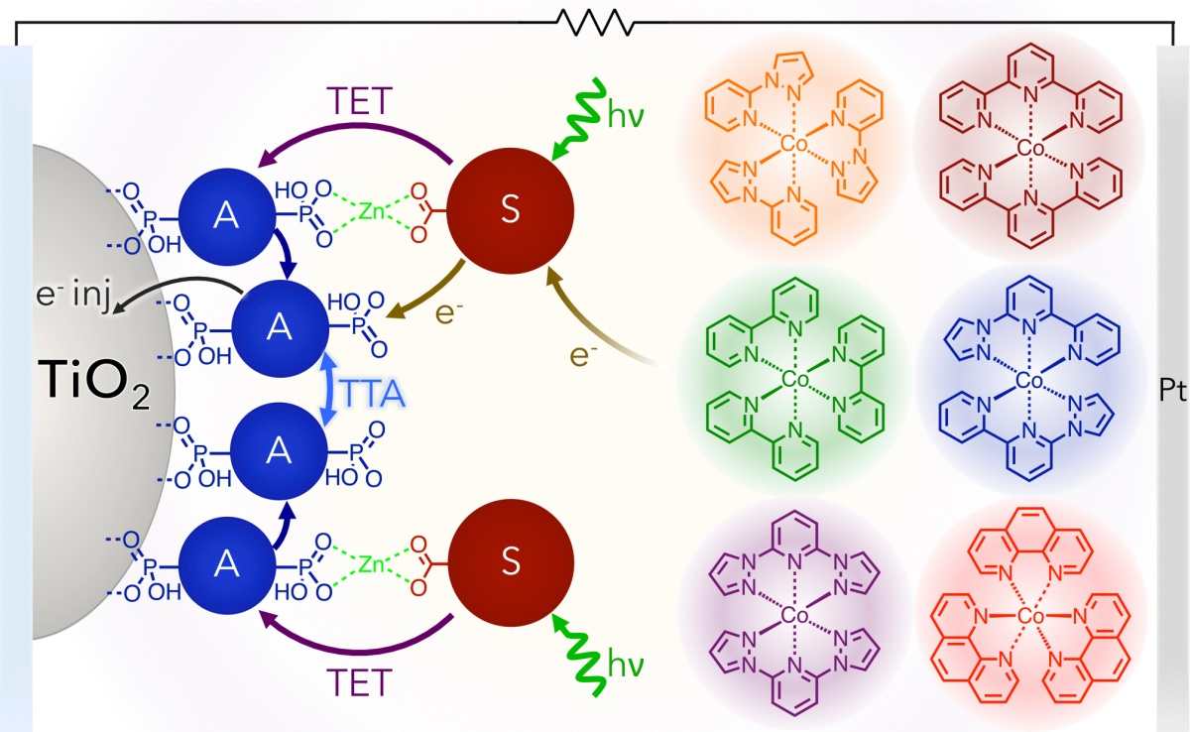
Increasing UC Photocurrent (J_{UC})
JPC Lett., 2018, 9, 5810
158 μA/cm²
JACS 2017 , 139, 10988.

Slide 24
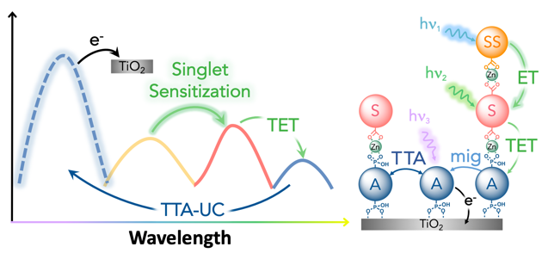
Increasing UC Photocurrent (J_{UC})
JPC Lett., 2018, 9, 5810
ACS Energy Lett. 2019, 4, 1458.
315 μA/cm²
158 μA/cm²
JACS 2017 , 139, 10988.

Slide 25
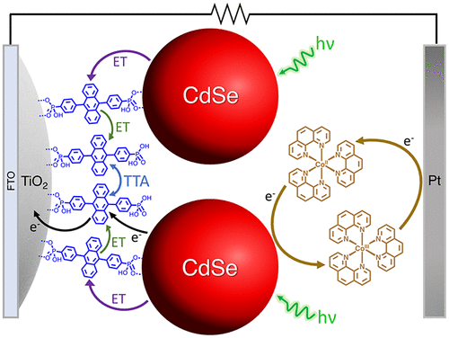
Increasing UC Photocurrent (J_{UC})
JPC Lett., 2018, 9, 5810
29 μA/cm²
ACS Appl. Energy Mater. 2020, 3, 29.

Slide 26
Increasing UC Photocurrent (J_{UC})
JPC Lett., 2018, 9, 5810
JPC C 2020, 43, 23597.
12 μA/cm²
29 μA/cm²
ACS Appl. Energy Mater. 2020, 3, 29.

Slide 27
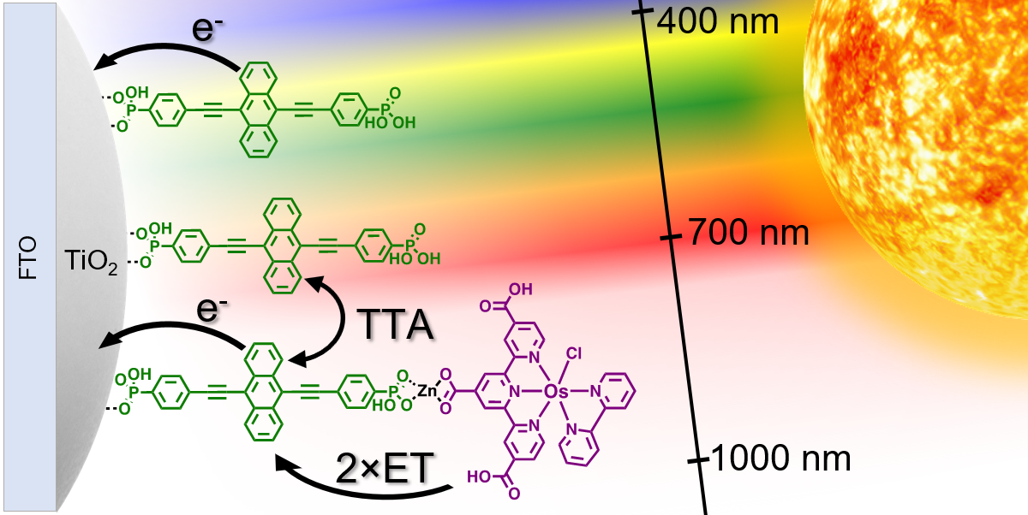
Increasing UC Photocurrent (J_{UC})
JPC Lett., 2018, 9, 5810
JPC C 2020, 43, 23597.
12 μA/cm²
3.5 μA/cm²
29 μA/cm²
ACS Appl. Energy Mater. 2020, 3, 29.
JMC C 2022, 10, 4947.

Slide 28
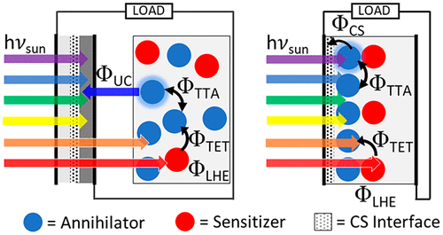
Increasing UC Photocurrent (J_{UC})
JPC Lett., 2018, 9, 5810
Performance Limitations:
ACS AM&I 2021, 13, 32601.

Slide 29
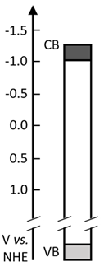
Energy and Electron Transfer
Upconversion Trilayer
¹A*
k_{BET2}
k_{inj(}1_{A*)}
k_{BET1}
¹F*
k_{inj(S*)}
¹S*
k_{ET1}
k_{inj(}3_{A*)}
γ_{TTA}
k_{ISC}
k_{BTET}
³F*
k_{mig}
k_{TET}
³S*
k_{r(F*)}
k_{BeT1}
³A*
k_{ex(S)}
k_{r(}1_{A*)}
k_{r(}3_{S*)}
k_{ex(F)}
k_{nr(F*)}
k_{nr(}1_{A*)}
k_{nr(}3_{S*)}
k_{nr(}3_{A*)}
k_{BeT2}
k_{et}
k_{et}
¹F
¹A
¹S
Glass
TiO₂
e⁻ Acceptor
Annihilator
Triplet Sensitizer
Singlet Sensitizer
ACS Energy Lett. 2019, 4, 6, 1458

Slide 30
Energy and Electron Transfer
Upconversion Trilayer
Photosynthesis
¹A*
k_{BET2}
4.4x10⁹
k_{inj(}1_{A*)}
4.5x10¹¹
k_{BET1}
1.9x10⁷
¹F*
k_{inj(S*)}
1.6x10⁶
¹S*
k_{ET1}
3x10¹¹
k_{inj(}3_{A*)}
1.6x10⁶
γ_{TTA}
1.0x10⁻¹⁵
k_{ISC} >10¹²
k_{BTET}
~0
³F*
k_{mig}
k_{TET}
1.3x10⁴
³S*
k_{r(F*)}
5.9x10⁸
k_{BeT1}
9.5x10⁶
³A*
k_{ex(S)}
>10¹⁵
k_{r(}1_{A*)}
2.5x10⁸
k_{r(}3_{S*)}
2.5x10²
k_{ex(F)}
>10¹⁵
k_{nr(F*)}
5.8x10⁸
k_{nr(}1_{A*)}
2.3x10⁸
k_{nr(}3_{S*)}
1.7x10⁴
k_{nr(}3_{A*)}
4.9x10³
k_{BeT2}
5.5x10⁶
k_{et}
<10⁶
k_{et}
<10⁶
¹F
¹A
¹S
Glass
TiO₂
e⁻ Acceptor
Annihilator
Triplet Sensitizer
Singlet Sensitizer
ACS Energy Lett. 2019, 4, 6, 1458
https://doi.org/10.48550/arXiv.1608.06913

Slide 31
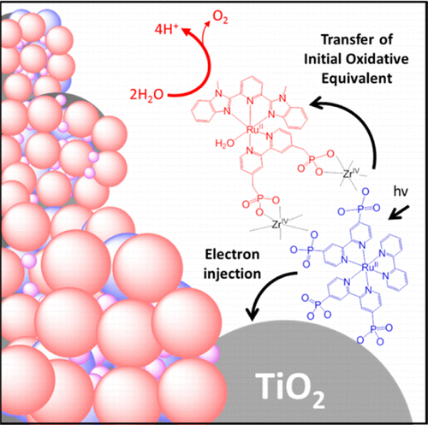
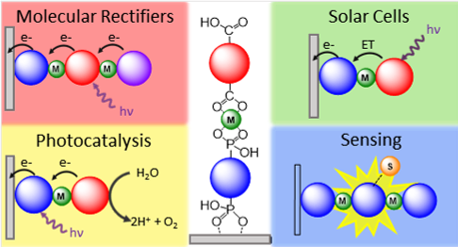
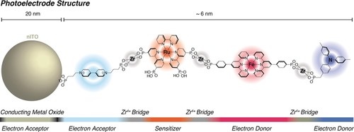
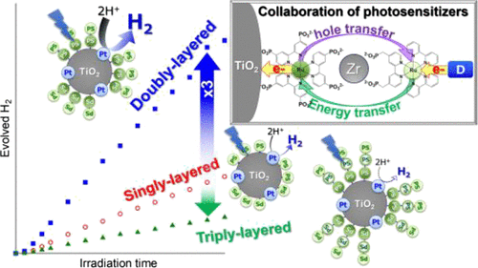
Metal Ion Linked Multilayer Structure
Water Oxidation DSPEC
Energy/Electron Transfer Cascade
ACS AM&I 2016, 8, 28633
Chem. Sci. 2021, 12, 50.
Molecular Rectifiers
H₂ Generation
ACS Appl. Opt. Mater. 2023, 1, 1156.
Angew. Chemie. 2018, 57, 15390.
ACS Omega, 2017, 2, 3901.
Notes:
Kato out of Hokkaido University

Slide 32
Bilayer Structure
What is known:
Not co-deposition
Metal-ion coordination
Directional E/e⁻ transfer
What is not known:
Surface binding angle
Relative orientation
Controllability

Slide 33
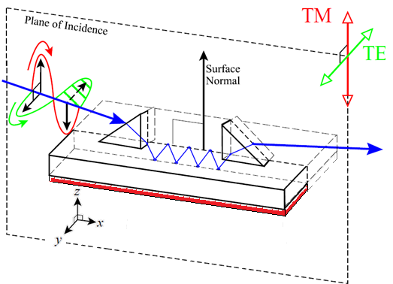
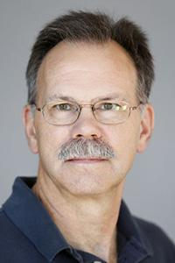
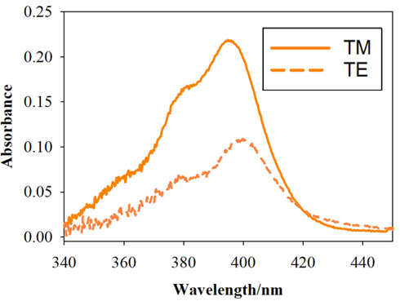
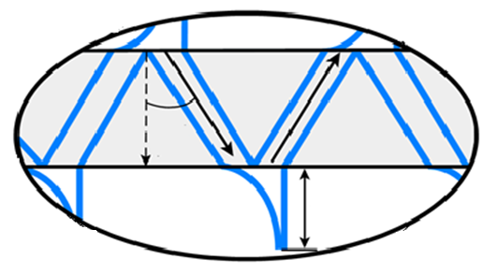
Polarized Attenuated Total Reflectance
Prof. Scott Saavedra at UofA
Measure A_{TE} and A_{TM}
ITO coated glass substrate
Dichroic ratio $ρ=\frac{A_{TE}}{A_{TM}}$
monolayer
Calculate mean tilt angle$θ$
Evanescent wave
John Thomas Bradshaw , A. PhD. Dissertation, University of Arizona, 2005

Slide 34
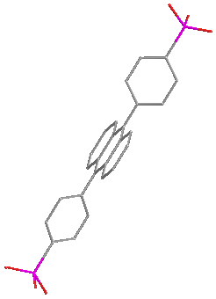
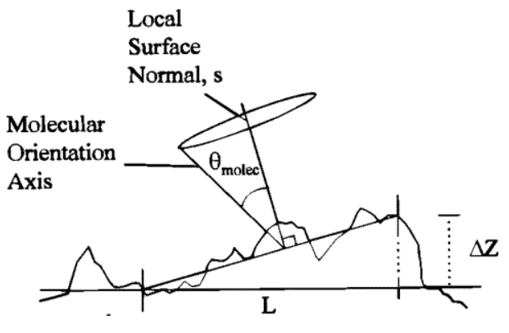
Metal Oxide-Anthracene Structure
ZrO_{2,} Al₂O₃
38º
37º
44º
30º
CB
e⁻
S₁
e⁻
CB
TiO₂
TiO₂
ZrO₂
Al₂O₃
ITO
Roughness:
1.2±0.4nm
1.1±0.3nm
2.2±0.5nm
0.5±0.1 nm
E
ITO
S₀
e⁻
VB
@0 nm roughness, tilt angle = 22º
Rowlen et al. JPC C 1999, 103, 1525.

Slide 35
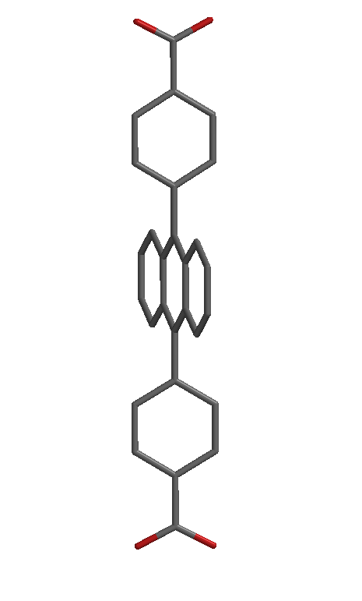
Metal Oxide-Anthracene Structure
ZrO_{2,} Al₂O₃
38º
37º
44º
30º
CB
e⁻
S₁
e⁻
CB
TiO₂
TiO₂
ZrO₂
Al₂O₃
ITO
Roughness:
1.2±0.4nm
1.1±0.3nm
2.2±0.5nm
0.5±0.1 nm
Similar angle regardless of metal oxide.
Binding group does not change the angle.
JPC C 2023, 127, 2705
E
ITO
S₀
e⁻
VB
30º
31º
PO₃H₂ vs COOH
ITO
ITO

Slide 36
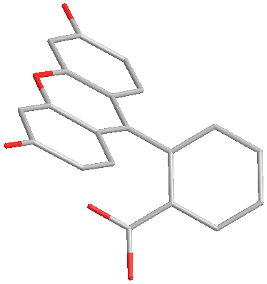
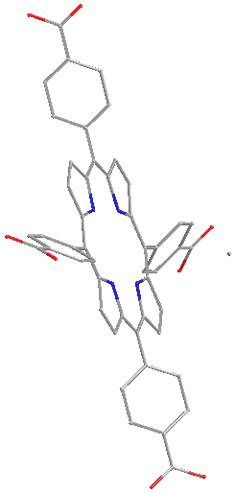
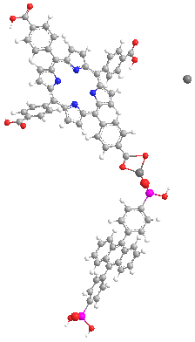
Multilayer Structure
One possible structure.
75º
Zn
37º
40º
Zn
Zn
Zn
31º
33º
38º
39º
ITO
ITO
ITO
ITO
ITO
Langmuir 2023, 39, 10670.

Slide 37
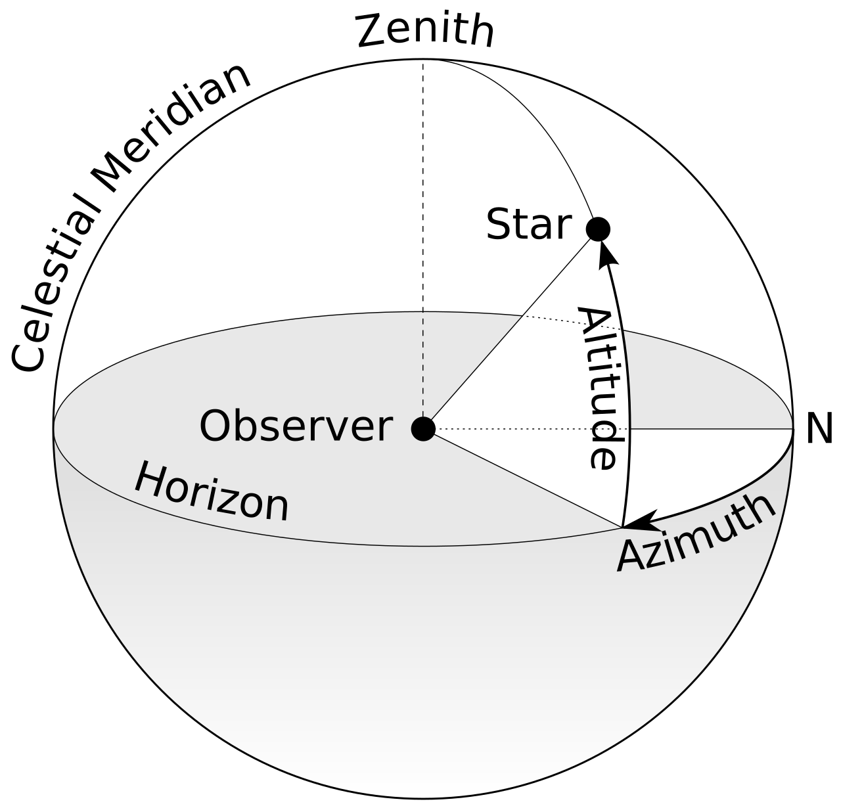
Multilayer Structure
75º
Azimuthal Angle
Zn
40º
Is the angular measurement in a spherical coordinate system which represents the horizontal angle from a frame of reference (usually North).
Zn
39º
Can determine structure if we know the angle between the chromophores!
ITO

Slide 38
FRET and Structure
Acceptor
A
$$E=\frac{1}{{1+\left(\frac{r}{R_{0}}\right)}^{6}}$$
r
θ_{A}
r
FRET
$$R_{0}=9780{\left. [J{ ϕ}_{D}{ n}^{−4}{\text{κ}}^{2}\right]}^{1/6}$$
D
A
J = overlap integral
$ϕ_{D}$= fluorescence QY of D
n= refractive index
κ²= orientation factor
r = distance
θ_{T}
θ_{D}
Donor
κ²= (cos θ_{T} – 3 cos θ_{D} cos θ_{A})²
Lakowicz, J.R. Principles of Fluorescence Spectroscopy, 3rd ed; Springer Science: New York 2006

Slide 39
FRET and Relative Orientation
P3
P2
P1
FRET
λ_{Ex}=360 nm

Slide 40
FRET and Relative Orientation
P3
Transient Absorption
P2
$$E=\frac{1}{{1+\left(\frac{r}{R_{0}}\right)}^{6}}$$
A*
P1
$$R_{0}=9780{\left. [J{ ϕ}_{D}{ n}^{−4}{\text{κ}}^{2}\right]}^{1/6}$$
P*
P*
J = overlap integral
$ϕ_{D}$= fluorescence QY of D
n= refractive index
κ²= orientation factor
r = distance
FRET
Sample | τ (ps) | Φ_{FRET}
ZrO₂-A-Zn-P1 | 38 | 99%
ZrO₂-A-Zn-P2 | 41 | 99%
ZrO₂-A-Zn-P3 | 175 | 97%
J, Φ_{D}, and n are known/the same.
Use change in r/E to find κ².
(assumes constant κ² for P1-3)
λ_{Ex}=360 nm

Slide 41
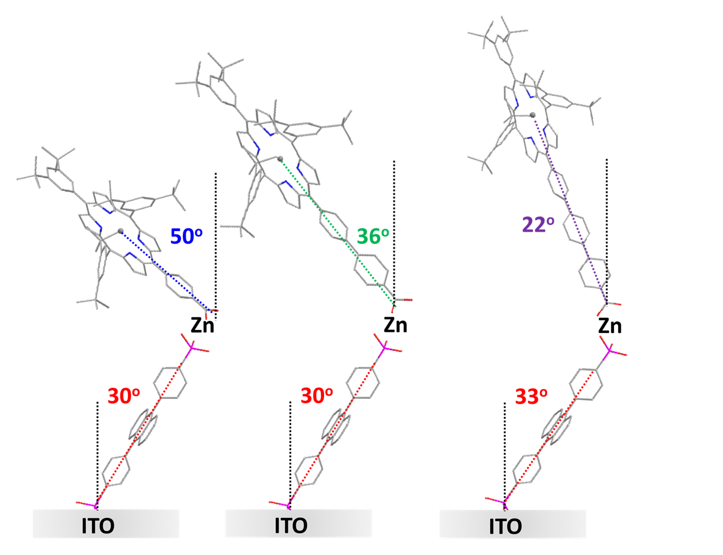
Polarized ATR
ITO coated glass substrate
monolayer
Both κ² and r are changing.
This method will not work.
Also, this is only one possible orientation!
Evanescent wave

Slide 42
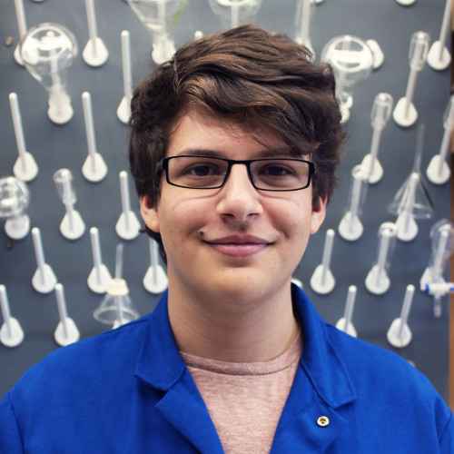
Porphyrin Orientation
θ_{A}
$$\hat{k}$$
$$\overset{⃑}{N}$$
θ_{N}
θ_{P}
θ_{D}
$$\hat{j}$$
θ_{rot}
Cory Ruchlin, McGill
Former FSU UG

Slide 43
Porphyrin Orientation
$$α=\frac{\arccos{(\overset{⃑}{r_{A}}∙\overset{⃑}{r_{DA}})}}{l_{A}\left\|\overset{⃑}{r_{DA}}\right\|}$$
$$μ_{1x}=\sin{θ_{D}}\cos{φ}$$
$$\overset{⃑}{N}= \hat{μ_{1}}×\hat{μ_{2}}$$
$$μ_{1y}=\sin{θ_{D}}\sin{φ}$$
$$\overset{⃑}{N}∙\hat{k}=\sin{θ_{P}}$$
$$β_{1}=\frac{\arccos\left(\hat{μ_{1}}∙\overset{⃑}{r_{DA}}\right)}{\left\|\overset{⃑}{r_{DA}}\right\|}$$
$$μ_{1z}=\cos{θ_{D}}$$
$$μ_{2x}=−sin{θ_{rot}}\cos{θ_{D}}\cos{φ}−\cos{θ_{rot}}\sin{φ}$$
$$β_{2}=\frac{\arccos\left(\hat{μ_{2}}∙\overset{⃑}{r_{DA}}\right)}{\left\|\overset{⃑}{r_{DA}}\right\|}$$
$$μ_{2y}=\cos{θ_{rot}}\cos{φ}−sin{θ_{rot}}\cos{θ_{D}}\sin{φ}$$
$$μ_{2z}=\sin{θ_{rot}}\sin{θ_{D}}$$
$$γ_{1}=\frac{\arccos\left(\hat{μ_{1}}∙\overset{⃑}{r_{A}}\right)}{\left\|\overset{⃑}{r_{A}}\right\|}$$
$$\hat{k}$$
$$\overset{⃑}{N}$$
θ_{N}
$$γ_{2}=\frac{\arccos\left(\hat{μ_{2}}∙\overset{⃑}{r_{A}}\right)}{\left\|\overset{⃑}{r_{A}}\right\|}$$
θ_{P}
θ_{D}
$$\hat{j}$$
$$κ_{i}^{2}={\left(\cos{γ_{i}}−3\cos{α}\cos{β_{i}}\right)}^{2}$$
θ_{rot}
$$\left\langle κ^{2}\right\rangle =\frac{κ_{1}^{2}+κ_{2}^{2}}{2}$$
Cory Ruchlin, McGill
Former FSU UG

Slide 44
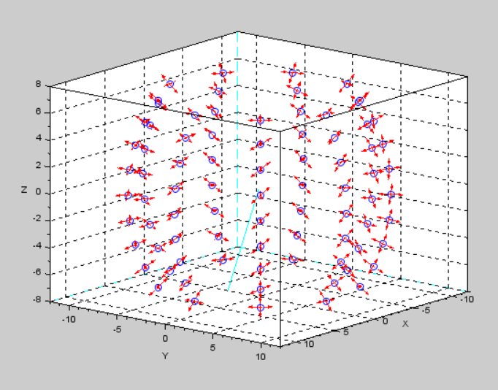



Porphyrin Orientation
Theoretical FRET Efficiency
$$Etheo=\frac{1}{{1+\left(\frac{r}{R_{0}}\right)}^{6}}$$
Axial dipole
Porphyrin centroid
Transverse dipole
$$R_{0}=9780{\left. [J{ ϕ}_{D}{ n}^{−4}{\text{κ}}^{2}\right]}^{1/6}$$
A vector
Black lines:
Theory agrees with experiment.
Possible porphyrin orientation.
Still not a unique answer.

Slide 45


Porphyrin Orientation
Theoretical FRET Efficiency
$$Etheo=\frac{1}{{1+\left(\frac{r}{R_{0}}\right)}^{6}}$$
$$R_{0}=9780{\left. [J{ ϕ}_{D}{ n}^{−4}{\text{κ}}^{2}\right]}^{1/6}$$
Possible orientation.
Not a unique answer.

Slide 46
Porphyrin Orientation
One transition dipole moment.
Is a fluorescent FRET acceptor.
Old Bilayer
New Bilayer

Slide 47
Emission Anisotropy
hν
530 nm
FRET
hν
hν
440 nm
360 nm

Slide 48




Emission Anisotropy
hν
530 nm
Nat. Commun. 2021, 12, 2541.
β
FRET
hν
445 nm
360 nm
hν

Slide 49
Emission Anisotropy
NanoMO₂
A
Zn
Bo
ZrO₂-A-Zn-B

Slide 50
Emission Anisotropy
NanoMO₂
A
Zn
Bo
ZrO₂-B
ZrO₂-A
ZrO₂-A-Zn-B

Slide 51
Emission Anisotropy
Emission Spectra
440 nm
360 nm

Slide 52
Emission Anisotropy
Emission Spectra
530 nm
450 nm
440 nm
360 nm

Slide 53
Emission Anisotropy
Emission Spectra
530 nm
450 nm
530 nm
FRET
440 nm
440 nm
360 nm
360 nm

Slide 54
Emission Anisotropy
Emission Spectra
530 nm
450 nm
530 nm
Excitation Spectra (575 nm emission)
FRET
440 nm
440 nm
360 nm
360 nm

Slide 55
Emission Anisotropy
Emission Spectra
530 nm
450 nm
530 nm
Excitation Spectra (575 nm emission)
FRET
440 nm
440 nm
360 nm
360 nm

Slide 56

Emission Anisotropy
530 nm
FRET
445 nm
G = I_{HV}/I_{HH}
r = $\frac{I_{VV} − G ∗ I_{VH}}{I_{VV} + 2∗ G ∗ I_{VH}}$
r = r_{o} ($\frac{1}{1+ τ/θ}$)
360 nm
$β$ = 37.5°
r_{o} = 0.4 ($\frac{3\cos^{2}\left(β\right) − 1}{2}$)

Slide 57
Bilayer Structure
$$β$$
37.5°
$β$ = 37.5°

Slide 58
Bilayer Structure
Emission Anisotropy
Polarized ATR
The Average Structure
?
+
=
$β$ = 37.5°
Θ = ?

Slide 59








Polarized Attenuated Total Reflectance
Prof. Scott Saavedra at UofA:
Retired Summer 2023
FSU Spectroscopy User Facility
DMR-EPM-2327754

Slide 60



Ongoing/Future Work
Anisotropy/Polarized ATR
Inhibiting Distortion
S₁
S₁
Energy
Energy
S₀
S₀
hν
hν
Ultrafast Transient Polarized ATR
Deformation Coordinates
Deformation Coordinates
Saavedra (unpublished)

Slide 61





Inhibiting Distortion
Steric Bulk
Strategic Surface Binding
hν
τ = 2800 ns
Φ = 6.3%
τ = 90 ns
Φ = 0.04%
hν
J. Phys. Chem. A 2015, 119, 13, 3181–3193

Slide 62
Decay Kinetics
1
2

Slide 63
Strategic Surface Binding
τ = ×5
τ = ×20
1
3

Slide 64

Conclusions
TTA-UC Emission
  On ZrO₂: Blue to green upconversion
  Quadratic to Linear Behavior
TTA-UC Solar Cell
  Improvements with component selection
  J_{UC} up to 315 μA/cm²
  Structure matters
Determine Structure (polarized ATR)
  1st layer orientation is MO_{x} independent
  2nd layer dependent on metal and binding group
  Reasonable agreement between ATR and Theory (MM)
Efforts to Control Structure are Underway

Slide 65






Other Research Efforts
Photomechanical Polymers
Chem. Ed. Research
Photochemical Separations
J. Chem. Educ. 2021, 98, 5, 1529.
ACS Appl. Polym. Mater. 2022, 4,4081
Z-Scheme H₂ Generation
J. Chem. Educ. 2023, 9, 3454.
Chem. Commun. 2018, 54, 7507
J. Am. Chem. Soc. 2022, 144, 21568
J. Chem. Educ. 2024, ASAP.

Slide 66



Every other Wed. 8-11 pm ET

Slide 67




Ask_a_Scientist_Gaming on Twitch.tv
Wed. July 3rd, 8-11 pm ET
Guest:
Prof. Bin Ouyang
(Chemistry & Biochemistry)
Expertise:
Computational chemistry
Machine learning
Energy storage materials
Games: Double Dragon
Contra
Super Mario Bros. NARC

Slide 68



Acknowledgements
  Not Pictured Contributors
  Dr. Ashley Arcidiacono (Uchicago, Postdoc)
  Dr. Suli Ayad
    (TCC, Prof.)
  Cory Ruchlin (McGill, Grad)
  Sarah Lindbom
  Luke Jodoin
  Collaborators
  Dr. Raaj Winfred (FSU)
  Dr. Igor Alabugin (FSU)
  Nikolas R. Dos Santos (FSU)
  Dr. Scott Saavedra (UA)
  Dr. Brooke Massani (UA)
  Dr. Bünyemin Çoşut (Gebze Tech)

Slide 69









Questions?
@HansonFSU

